Slide 1
CAR 143914191 Observation

Slide 2
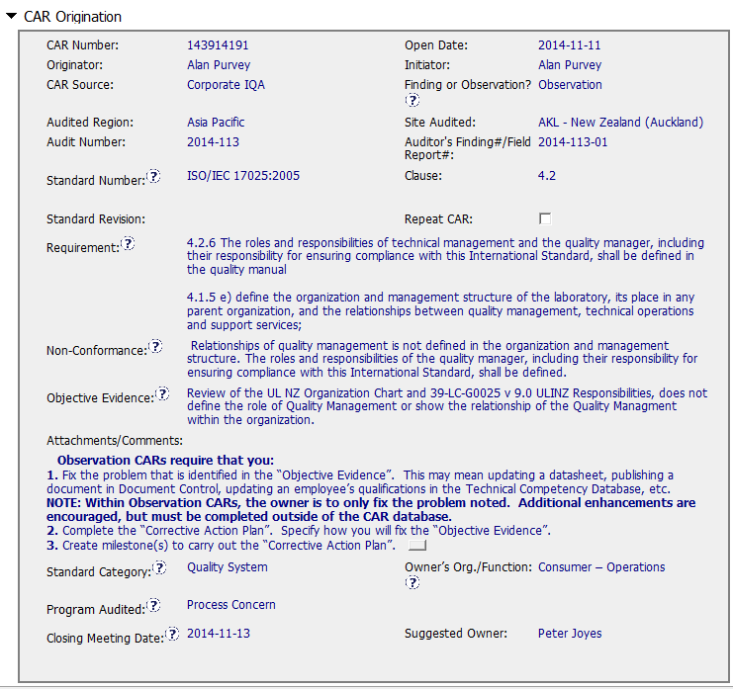


Slide 3
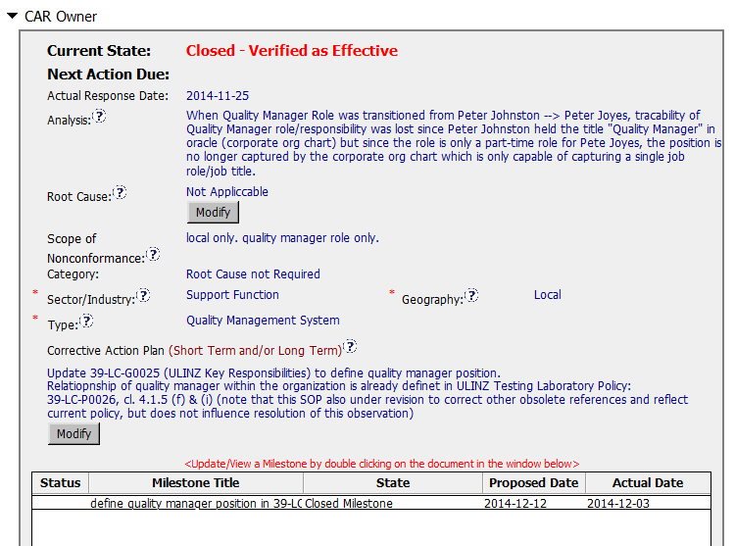
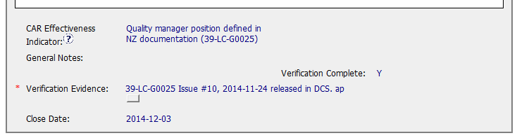
Analysis is not required for Observations (okay to include)

Slide 4
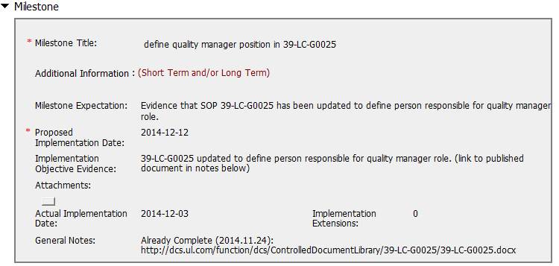

Objective evidence should have included:
Copy of the released document
Screen shot showing it was released to DCS

Slide 5
CAR History
2014/11/19 - CAR Assigned To Owner (clock starts)
2014-11-25 - CAR Response Submitted by Owner (elapsed time: 6 days)
2014/12/01 - Response Approved by CAR Administrator (elapsed time: 12 days)
2014-12-03 - CAR Implementation Submitted by Owner (elapsed time: 14 days)
2014/12/03 - CAR Closed by CAR Administrator (elapsed time: 14 days)
2014/12/03 - Verified as effective and closed by CAR Administrator (elapsed time: 14 days)
CAR resolved in two weeks – very good.

Slide 6
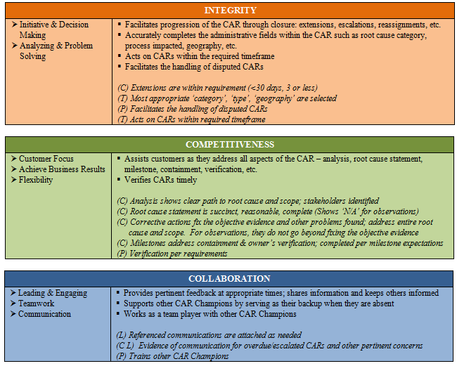
CBS
P
P
P – Impl.evidence
P
(C – Customer; T – Technical; L – Colleague; P – Process).

